Slide 1
Scalability

Slide 2
What Is Scalability?
Scalability describes a system’s elasticity. While we often use it to refer to a system’s ability to grow, it is not exclusive to this definition
If you are running a website, web service, or application, its success hinges on the amount of network traffic it receives. It is common to underestimate just how much traffic your system will incur, especially in the early stages. This could result in a crashed server and/or a decline in your service quality.
https://www.cloudzero.com/blog/horizontal-vs-vertical-scaling/

Slide 3
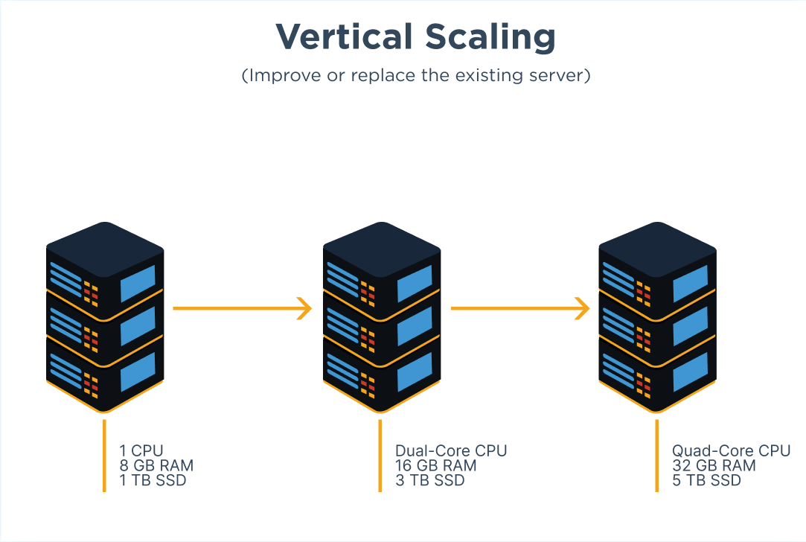
Vertical Scaling
Vertical scaling (aka scaling up) describes adding additional resources to a system so that it meets demand.

Slide 4
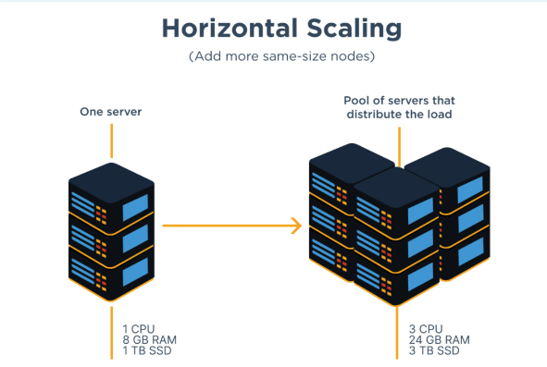
Horizontal Scaling
Horizontal scaling (aka scaling out) refers to adding additional nodes or machines to your infrastructure to cope with new demands. If you are hosting an application on a server and find that it no longer has the capacity or capabilities to handle traffic, adding a server may be your solution.

Slide 5
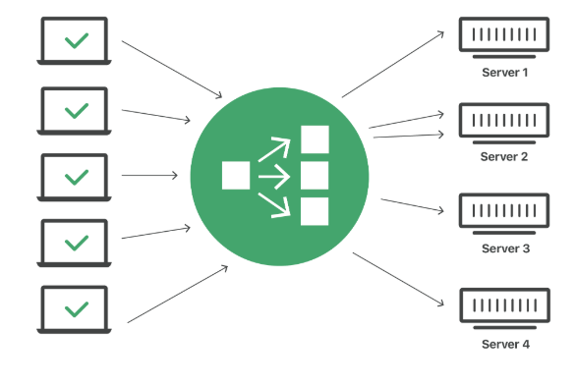
What is load balancing?
Load balancing is the practice of distributing computational workloads between two or more computers. On the Internet, load balancing is often employed to divide network traffic among several servers. This reduces the strain on each server and makes the servers more efficient, speeding up performance and reducing latency. Load balancing is essential for most Internet applications to function properly.
https://www.cloudflare.com/learning/performance/what-is-load-balancing/

Slide 6
OLAP and OLTP

Slide 7
OLTP Defined
OLTP or Online Transaction Processing is a type of data processing that consists of executing a number of transactions occurring concurrently—online banking, shopping, order entry, or sending text messages, for example. These transactions traditionally are referred to as economic or financial transactions, recorded and secured so that an enterprise can access the information anytime for accounting or reporting purposes.
https://www.oracle.com/ph/database/what-is-oltp/

Slide 8

What is OLAP?
Online analytical processing (OLAP) is software technology you can use to analyze business data from different points of view. Organizations collect and store data from multiple data sources, such as websites, applications, smart meters, and internal systems. (ex. Amazon Redshift, Snowflake)
https://aws.amazon.com/what-is/olap/

Slide 9

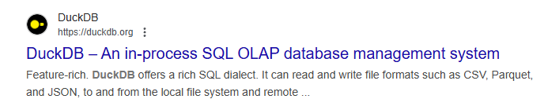

Slide 10
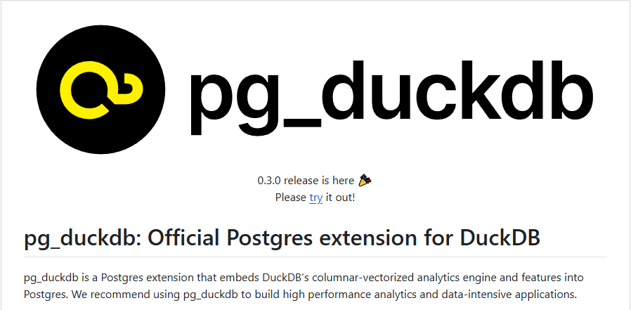

Slide 11
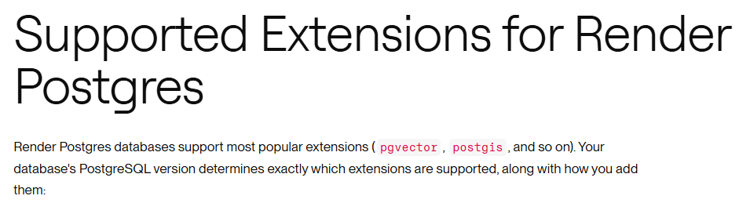

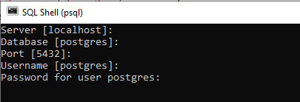

Slide 12
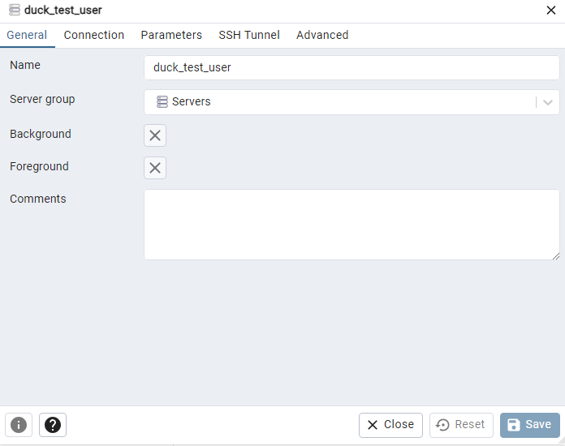
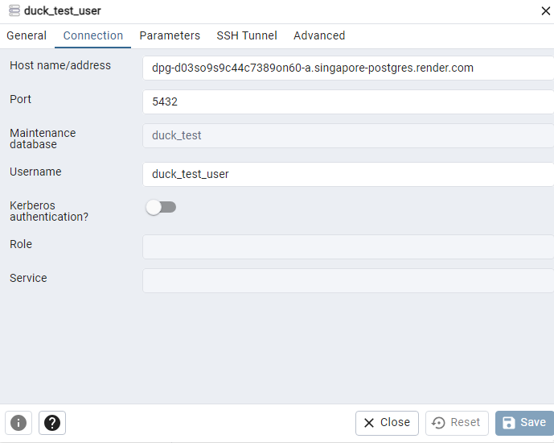
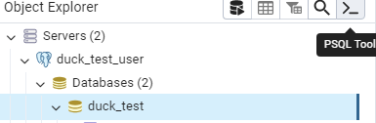
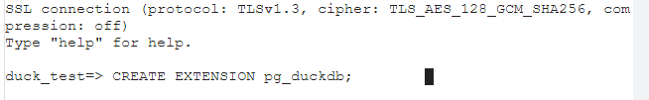

Slide 13
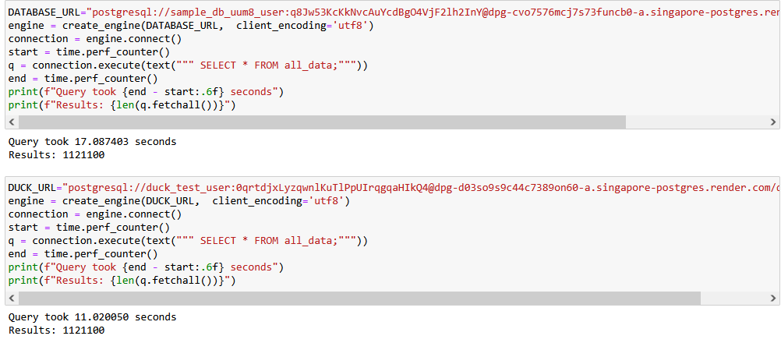

Slide 14
“
“The only limit to our realization of tomorrow will be our doubts of today.”
— Franklin D. Roosevelt

